Slide 1
EASA Regulation on Aerodromes Current Situation & Future Challenges
Vasileios Stefanioros
Aerodrome Regulations Officer
Frankfurt, 11/09/2014
TE.GEN.00409-001

Slide 2
Content
EU / EASA Legal Framework
Commission Regulation (EU) 139/2014
RFFS provisions
Future challenges

Slide 3
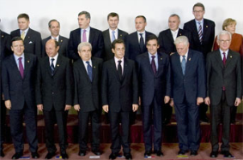
The European Institutions
Council of the European Union
European Council
European Court of Justice
European Parliament
European Commission
EASA

Slide 4
About EASA
Founded in 2003
Headquarters in Cologne, Germany
Local office in Brussels
ED - Mr Patrick Ky since September 2013
Staff of more than 750
Built on experience from the JAA

Slide 5
European Union and EFTA countries
28 EU states
4 EFTA states

Slide 6
EU Aviation Regulations
Economic regulation
Operations & FCL
3rd Country
Operations
Aerodromes
ATM/ANS
Airworthiness
Performance regulation
Safety regulation
total System approach
Interoperability regulation

Slide 7
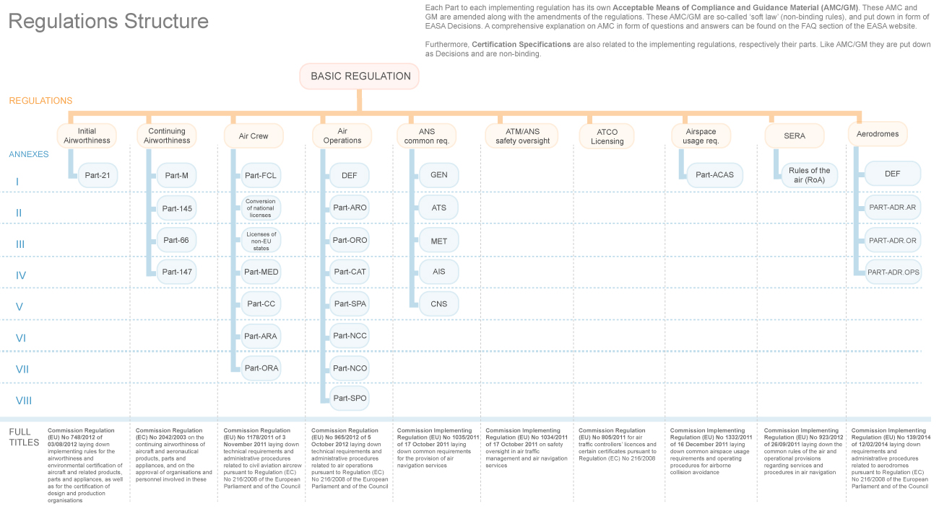
EU Aviation Regulations Structure

Slide 8
Basic Regulation and Aerodromes
Basic Regulation
Regulation (EC) 216/2008
Annex Va
Essential Requirements for Aerodromes
Commission Regulation (EU) 139/2014
Annex I - Definitions
EASA Decision
ED 2014/012/R
AMC & GM on
AR, OR & OPS
Annex II – (Part-ADR.AR) Authority Requirements
Annex III – (Part-ADR.OR) Organisation Requirements
EASA Decision
ED 2014/013/R
CS
Annex IV – (Part-ADR.OPS) Operations Requirements

Slide 9
Regulation (EU) 139/2014
Applicability
Aerodromes open to public use serving commercial air transport
Operations using instrument approach or departure procedures are provided, and:
Have a paved runway of 800 m or above; or
Exclusively serve helicopters
Member States may decide to exempt from the provisions an aerodrome which:
Handles no more than 10,000 passengers per year, and
Handles no more than 850 movements related to cargo operations per year

Slide 10
Regulation (EU) 139/2014
Cover Regulation
Article 1 – Subject matter and scope
Article 2 – Definitions
Article 3 - Oversight of aerodromes
Article 4 – Information to EASA
Article 5 – Exemptions
Article 6 – Conversion of certificates
Article 7 – Deviations from CSs
Article 8 – Safeguarding of aerodrome surroundings
Article 9 – Monitoring of aerodrome surroundings
Article 10 – Wildlife hazard management
Article 11 – Entry into force and application

Slide 11
Regulation (EU) 139/2014
PART – ADR.AR Authority Requirements
Defines the requirements for the Competent Authority such as:
Management System and Record keeping
How to deal with AMCs and AltMoC
Coordination with EASA
Reaction to safety problems and safety directives
Certification and oversight of aerodromes
Management of changes
Findings, observations, corrective actions and enforcement measures

Slide 12
Regulation (EU) 139/2014
PART – ADR.OR Organisations Requirements
Defines the requirements for the Aerodrome Operator:
Certification process
Management of changes
Aerodrome operator responsibilities
Occurrence reporting
Management System
Personnel requirements
Training and proficiency check programmes
Safety programmes, safety reporting system, record keeping
Aerodrome Manual

Slide 13
Regulation (EU) 139/2014
PART – ADR.OPS Operations Requirements
Defines the operational requirements for aerodromes:
Aerodrome data (quality requirements, coordination with AIS)
Emergency planning and RFFS
Monitoring and inspection of movement area
Wildlife control
Operation of vehicles, SMGCS
Winter operations, LVO, night operations, operations in adverse weather conditions
Fuel quality, Aerodrome works, safeguarding from obstacles, operation of higher code letter aircraft
Maintenance

Slide 14
RFFS Requirements
EASA Basic Regulation Annex Va
Adequate aerodrome RFFS are provided to respond to an incident or accident with due urgency and shall include at least equipment, extinguishing agents and a sufficient number of personnel
RFFS personnel shall be properly trained and qualified to operate in the aerodrome environment. The aerodrome operator shall implement and maintain training and check programmes to ensure the continuing competence of this personnel
All RFFS personnel potentially required to act in aviation emergency shall periodically demonstrate their medical fitness to execute their functions satisfactorily, taking into account the type of the activity. In this context, medical fitness, comprises both physical and mental fitness

Slide 15
RFFS Requirements
ADR.OPS.B.010 RFFS
The responsibilities of the aerodrome operator are the following:
To ensure the provision of facilities, equipment and services
To ensure the availability of required resources in a timely manner
To ensure the medical fitness of RFFS personnel
To establish a training programme for RFFS personnel
To implement proficiency checks at adequate intervals
To ensure the availability of qualified and experienced instructors and assessors and appropriate training facilities
To maintain proper training records for RFFS personnel

Slide 16
RFFS Requirements
AMC1 ADR.OPS.B.010(a)(2)
Communication and alerting systems
Discrete communication system between fire station(s), control tower and RFFS vehicles
Alerting system
Means for communication between RFFS personnel and aircraft in emergency
Means for summoning of designated personnel not on standby duty
Two-way communication between the RFFS vehicles attending an emergency
Communication between RFFS crews
Recording of communications in emergencies

Slide 17
RFFS Requirements
AMC2 ADR.OPS.B.010(a)(2)
RFFS level of protection
Same requirements with ICAO Annex 14
Reduction to the level of protection is allowed if accepted by the Competent Authority
AMC3 ADR.OPS.B.010(a)(2)
Number of RFFS vehicles and rescue equipment
Same requirements with ICAO Annex 14
Coordination of the availability of suitable rescue equipment and services when the aerodrome is located near a water/swampy area, or other difficult environment or a significant portion of the approach/departure operations takes over these areas

Slide 18
RFFS Requirements
AMC4 ADR.OPS.B.010(a)(2)
Extinguishing agents
Requirements are similar to ICAO Annex 14
Amendment 11 of Annex 14 has also been included (introduction of Type C foam)
AMC5 ADR.OPS.B.010(a)(2)
Response time
Not exceeding 3 min with an operational objective of 2 min to any point of each operational runway in optimum visibility and surface conditions
Response time to any other part of the movement area should be calculated and included in the AEP
Back up vehicles should arrive no more than 1 min after the first responding vehicles
Support to RFFS to meet the response time as nearly as possible in less than optimum visibility conditions (guidance, equipment or procedures

Slide 19
RFFS Requirements
AMC5 ADR.OPS.B.010(a)(2)
Response time
Not exceeding 3 min with an operational objective of 2 min to any point of each operational runway in optimum visibility and surface conditions
Response time to any other part of the movement area should be calculated and included in the AEP
Back up vehicles should arrive no more than 1 min after the first responding vehicles
Support to RFFS to meet the response time as nearly as possible in less than optimum visibility conditions (guidance, equipment or procedures

Slide 20
RFFS Requirements
AMC6 ADR.OPS.B.010(a)(2)
Personnel
Availability of personnel during flight operations and at least 15 min after the departure of last flight
Deployment of personnel in order to meet response time
Provision of protective clothing and respiratory equipment
Any other duties do not compromise response and safety of RFFS personnel

Slide 21
RFFS Requirements
GM1 ADR.OPS.B.010(a)(3)
Training of RFFS personnel
Includes subjects that RFFS personnel should be trained
Based in ICAO Annex 14, Attachment A, 18.2
AMC1 ADR.OPS.B.010(a)(4)
Medical Standards
The aerodrome operator to ensure that appropriate medical standards are met by RFFS personnel

Slide 22
RFFS Requirements
AMC1 ADR.OPS.B.010(b);(c)
Training programme of RFFS personnel
Training should be completed before initial performance of their duties
Training on Safety Management
Training programme should include:
A process to identify training standards, including syllabi, frequency for each position, including instructors and assessors
Validation process to measure the effectiveness of the training
Initial job-specific training
On-the-job training
Recurrent training
Active participation in live fire drills, including pressure-fed fuel drills
Training in human performance, including team coordination

Slide 23
RFFS Requirements
AMC2 ADR.OPS.B.010(b);(c)
Checking of RFFS trainees
Should be accomplished by the method appropriate to the training element to be checked
Training elements that require individual participation may be combined with practical checks
Suggested checks and training frequencies (relevant GM):
Initial training to be valid for 12 months
Recurrent training every 12 months
Refresher training when personnel is out of duty for a significant period of time
Differences training when personnel is assigned to other duties or changes aerodrome
Proficiency checks normally every 24 months

Slide 24
RFFS Requirements
AMC1 ADR.OPS.B.010(d)
Instructors – Assessors
Nominated by the aerodrome operator
May include contracted instructors for individual subjects
May include personnel proposed by organisations operating or providing services at the aerodrome
Instructors may not be assessors for their own instructions, courses or material
Establishment of qualification criteria for instructors and assessors

Slide 25
Current situation
By the end of 2017 aerodromes under the scope of Regulation 139/2014 has to be certified or their current certificates to be converted in accordance with the provisions of the Regulation
RFFS requirements must be met by that time as well
Regulation 139/2014 does not change many things in the provision of RFFS
Allows flexibility and proportionality

Slide 26
Future challenges
Level of protection to be provided for all cargo flights
More consistent application of the remission factor
Development of medical standards for RFFS personnel
EASA has initiated RMT.0589 to deal with the above issues
Expected publication of EASA Opinion in Q1/2016

Slide 27
References
Commission Regulation (EU) No 139/2014
http://eur-lex.europa.eu/search.html?instInvStatus=ALL&or0=DTS%3D3,DTS%3D0&or1=DTT%3DR&DTN=0139&DTA=2014&qid=1399543028151&DTC=false&DTS_DOM=ALL&type=advanced&SUBDOM_INIT=ALL_ALL&DTS_SUBDOM=ALL_ALL
EASA AMC/GM
http://easa.europa.eu/regulations

Slide 28
Thank you very much for your attention

